Slide 1

Speech Pro
Developers:
Rameen Ihtesham (2022-CS-87)
Maryam Waseem (2022-CS-101)

Slide 2
Overview: Assessing and Improving English Fluency
The Challenge
The Solution
Many people struggle to achieve English fluency. Traditional methods can be expensive and time-consuming.
The AI Fluency Tester provides personalized feedback and tailored exercises to improve fluency and pronunciation.

Slide 3

Technologies Used
Python
Django
Speech Recognition APIs
Python's versatility and large library ecosystem made it ideal for developing the AI model.
Django's framework streamlined the development of the web application and its user interface.
APIs like Google Cloud Speech-to-Text enabled real-time audio processing and analysis.

Slide 4
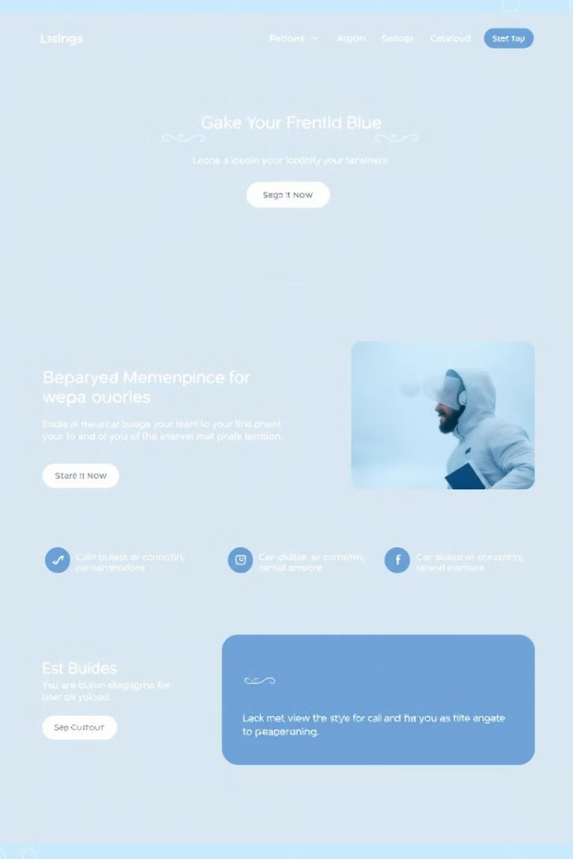




Key Features
User Registration
Audio Processing
Users can create accounts and track their progress.
The system analyzes fluency, pronunciation, and speaking time.
Level-based Tests
Weekly Progress Reports
Tests are tailored to user proficiency levels.
Users receive detailed summaries of their performance.

Slide 5
Development Process
Requirement Gathering
1
Defining user needs and functionality.
2
Technology Selection
Choosing the most appropriate tools and platforms.
AI Model Development
3
Training the AI to recognize and analyze speech.
4
UI/UX Design
Creating an intuitive and user-friendly interface.
Testing and Deployment
5
Thoroughly testing and deploying the application.

Slide 6



Challenges and Limitations
Language Limitation
1
Only English Language supported.
Speech Recognition Accuracy
2
Ensuring the AI accurately transcribes and analyzes speech.
User Feedback Integration
3
Developing a system to incorporate user feedback for continuous improvement.

Slide 7
Future Steps
Expand Language Support
1
Adding support for other languages besides English.
Integrate Adaptive Learning
2
Personalizing learning paths based on user progress.
Develop Mobile App
3
Making the AI Fluency Tester accessible on mobile devices.

Slide 8

Conclusion
The AI Fluency Tester offers a promising solution for improving English fluency. By leveraging advanced technologies and a user-centric approach, it can empower individuals to reach their language learning goals. The project's future holds exciting possibilities for expansion and innovation.

Slide 9

Q&A
Thank you for your time. We welcome your questions and feedback.

